Slide 1
HR Analytics Case Study (Logistics Regression)
Group Name:
Deepak Aneja
Suresh Balla
Merin Jose
Fayiz Mayam Veettil
25 Mar 2018

Slide 2
Problem Statement
Objective
Understand the factors in order to curb attrition of the Company XYZ
Know which of the variables is most important and needs to be addressed right away
Company want to know what changes they should make to their workplace, in order to get most of their employees to stay in the company

Slide 3
Data Exploration
Dataset
Contains information about the employees working in the Company XYZ
Around 4,400 employees records from Jan ’15 to Dec ’15
30 different variables to understand the employees behaviour and status in the dataset
Dataset across five different sheets including
General Information
Daily time in and time out details
Employees’ and Managers’ job satisfaction and work life balance survey data
The aim is to model the probability of attrition using a logistic regression

Slide 4
Step by Step Approach for Analysis
Cleaning and formatting data
Derive useful metrics out of data
Data Binning based on WOE and IV
Check the data density and correlations
Data Scaling
Splitting the data between train and test
Data Modeling
Conclusion

Slide 5
Data Cleaning and Manipulation
Check for possible data inconsistencies
Check for duplicate records
Check for NA values in the columns used for analysis
Status of data cleaning
No duplicate records found
Uses the column ‘Attrition’ as targeted variable
38 dummy variables were created for modeling

Slide 6
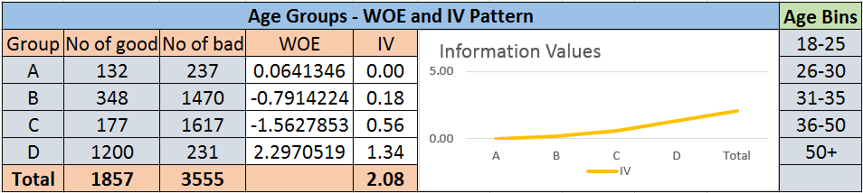
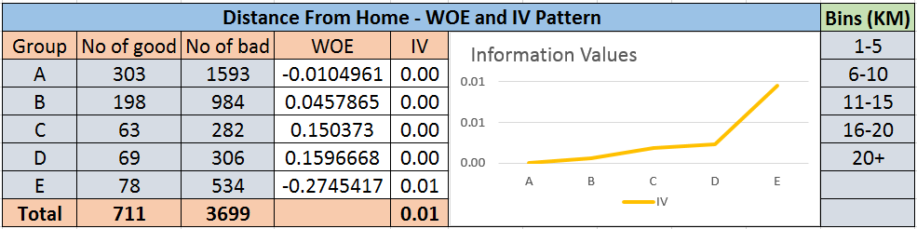
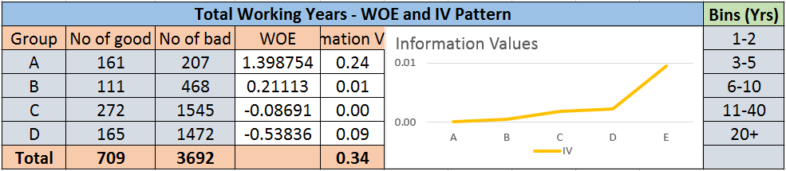
Binning of Continuous Variable using WOE and IV
Variables tested with WOE and IV Factors
Bins Worked
Age
Distance From Home
Total Working Year
Bins Didn’t Work
Year At Company
Years with Cur. Manager
Monthly Income

Slide 7
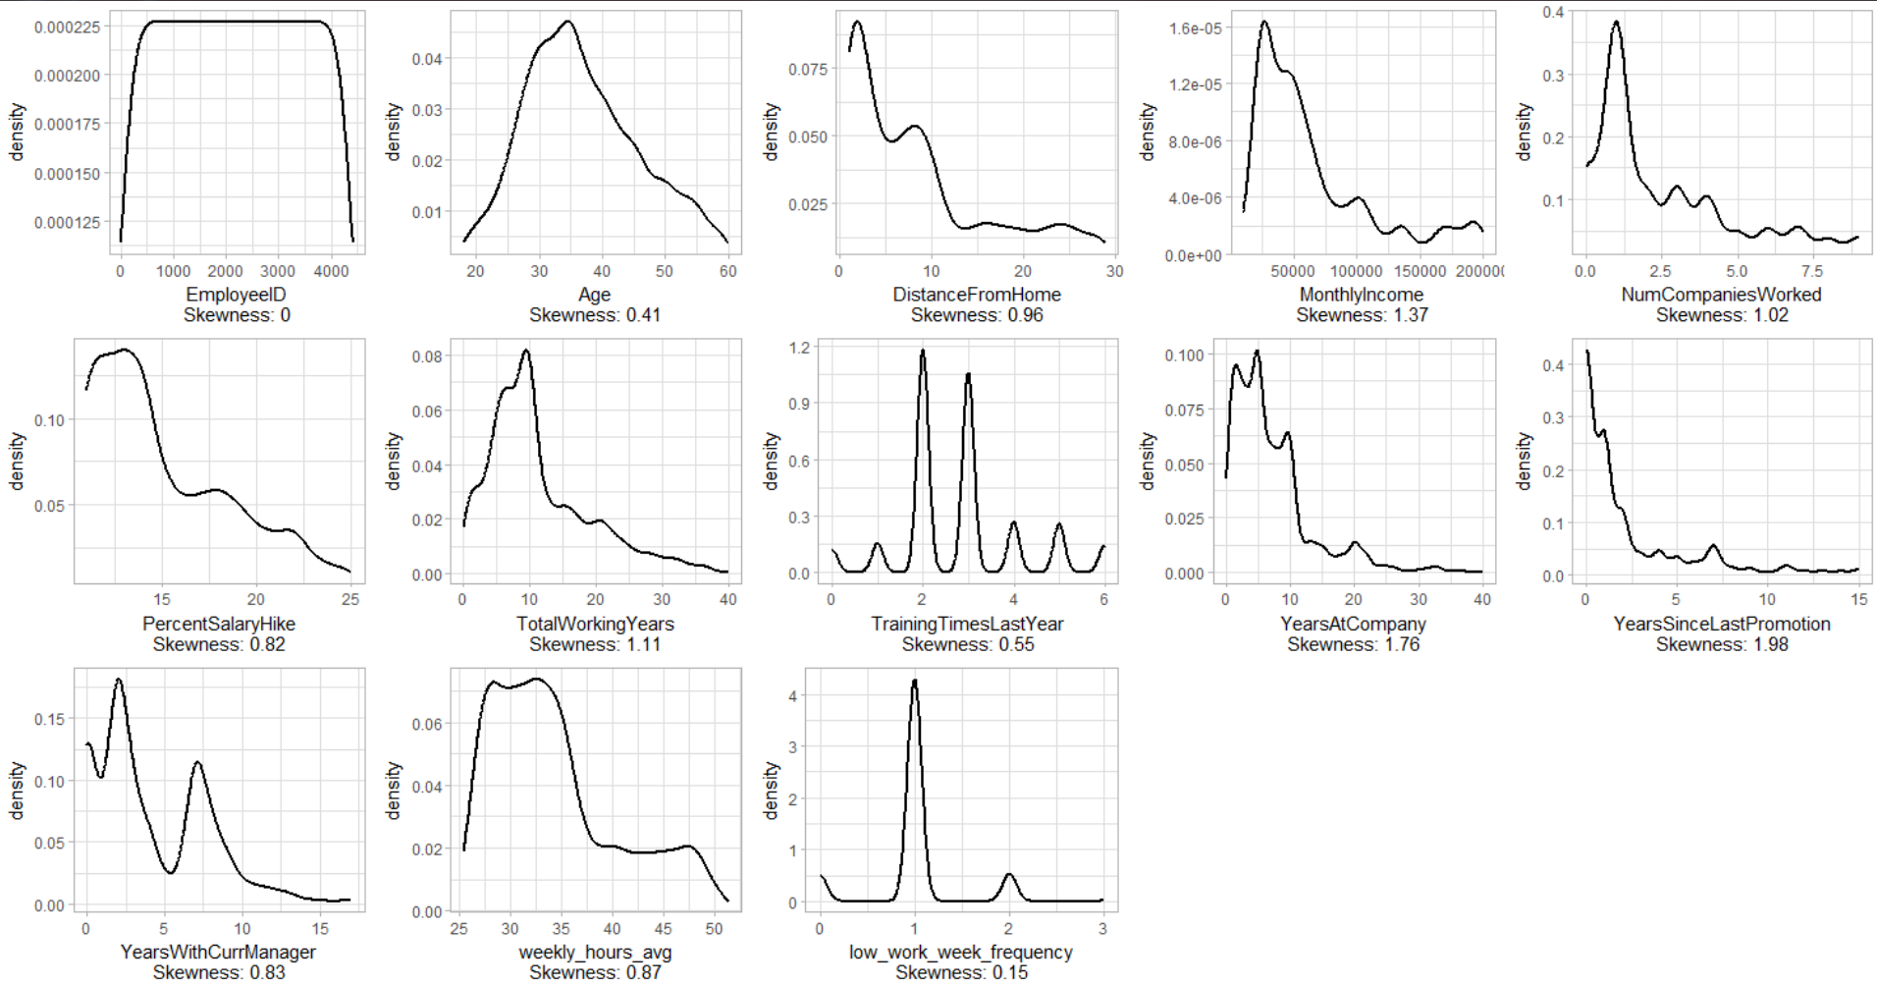
Data Density - I
Data density check on numerical data for further modeling

Slide 8
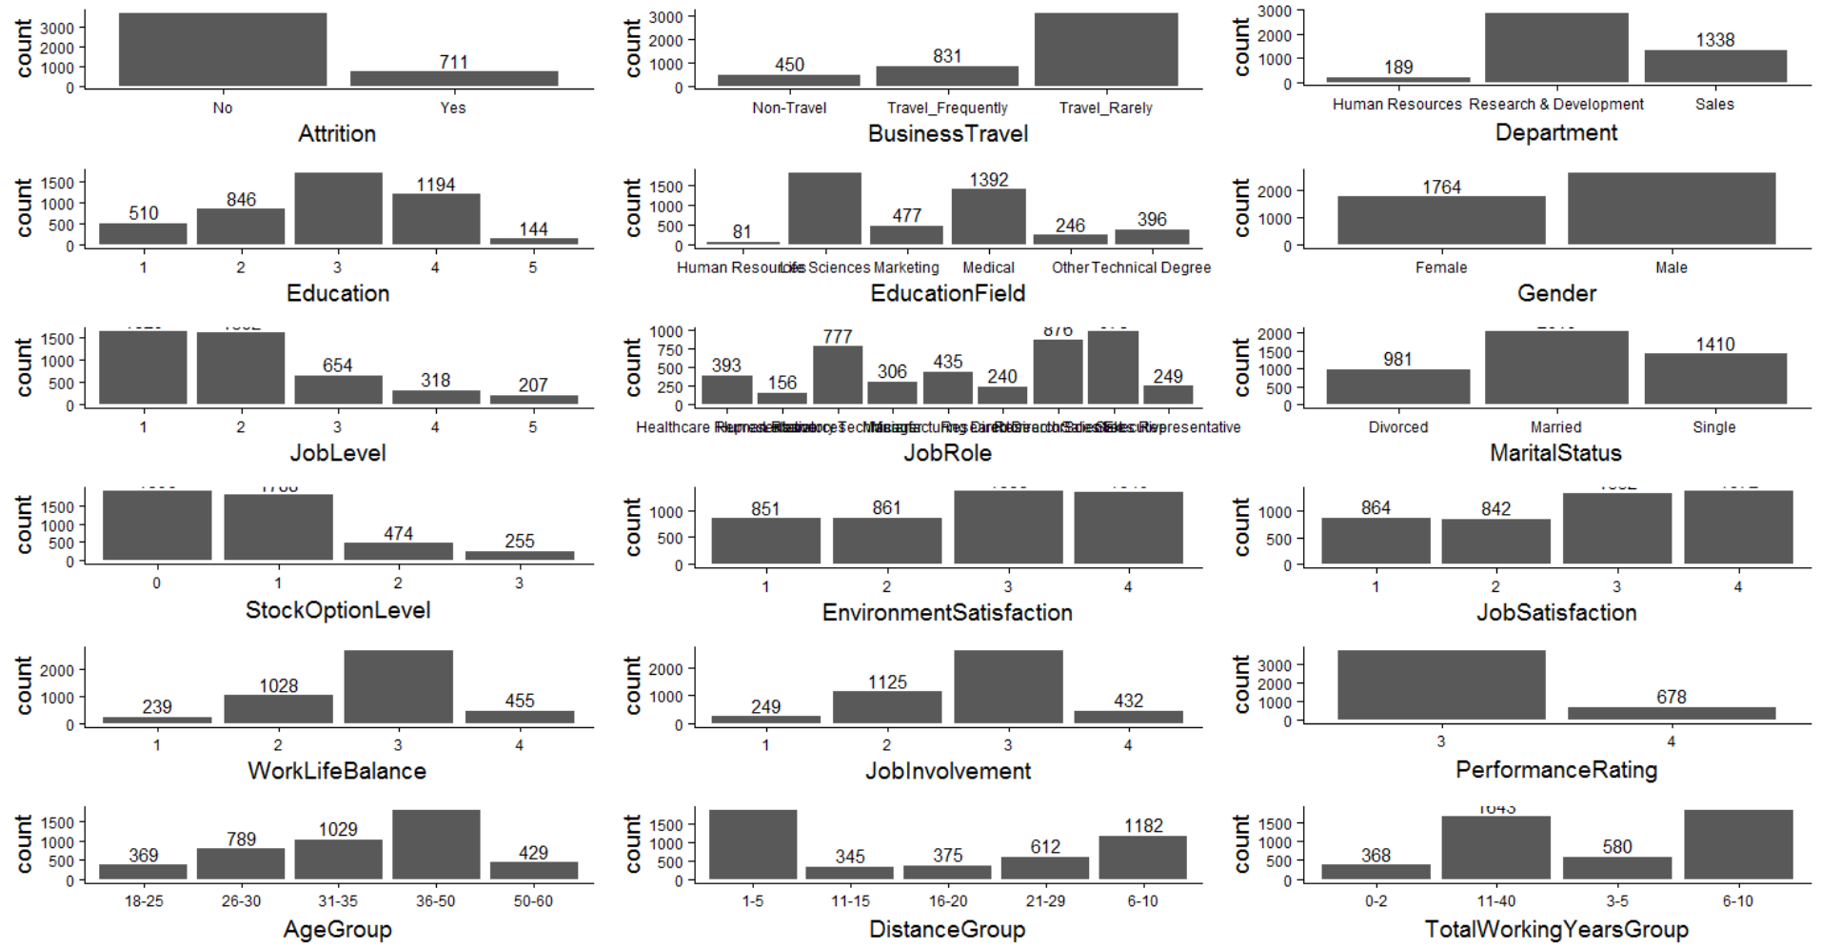
Data Density - II
Data density check on categorical data for modeling

Slide 9
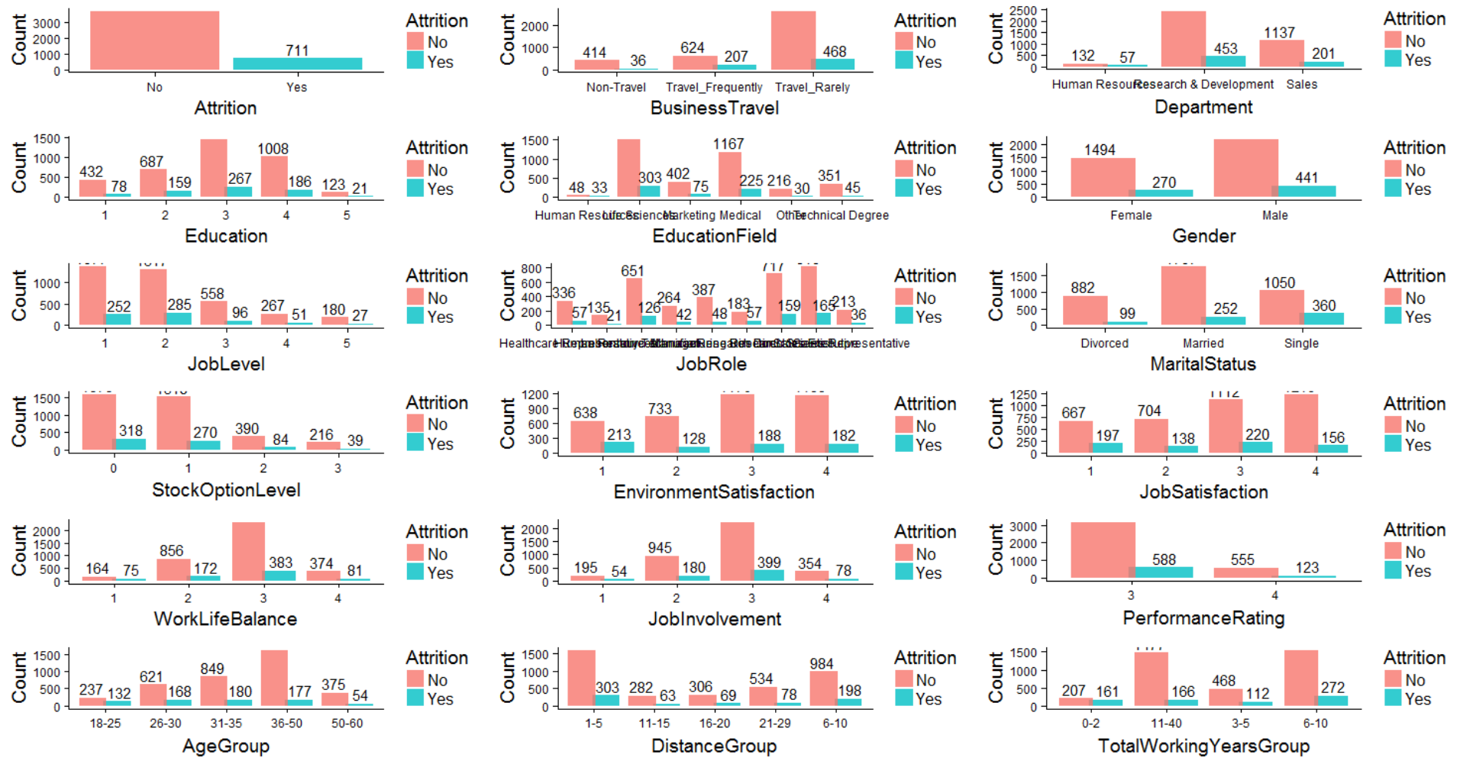
Univariate Analysis - I
Status of variables relative to attrition

Slide 10
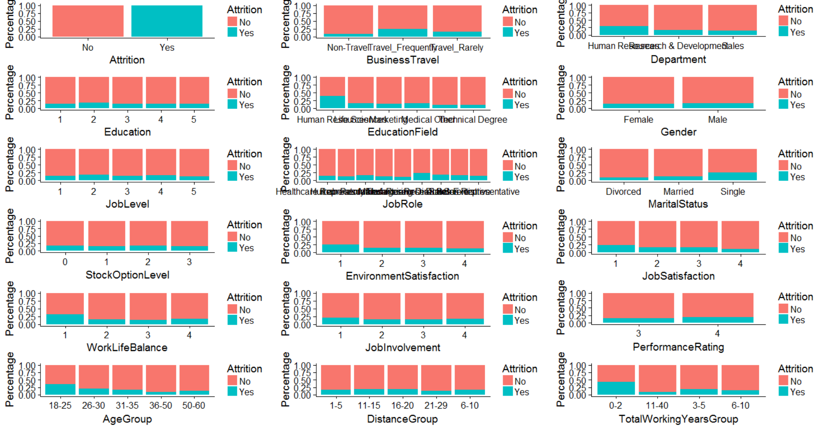
Univariate Analysis - II
Percentage of variables relative to attrition

Slide 11
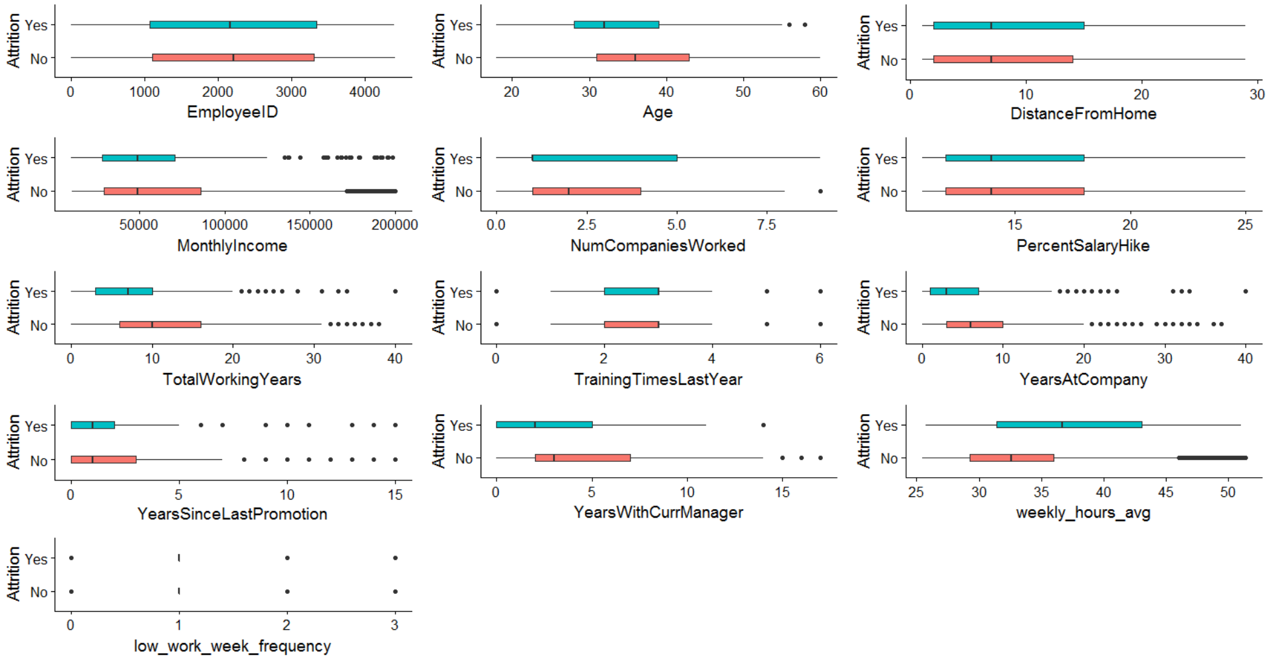
Attrition Status
Numeric box plots against attrition status

Slide 12
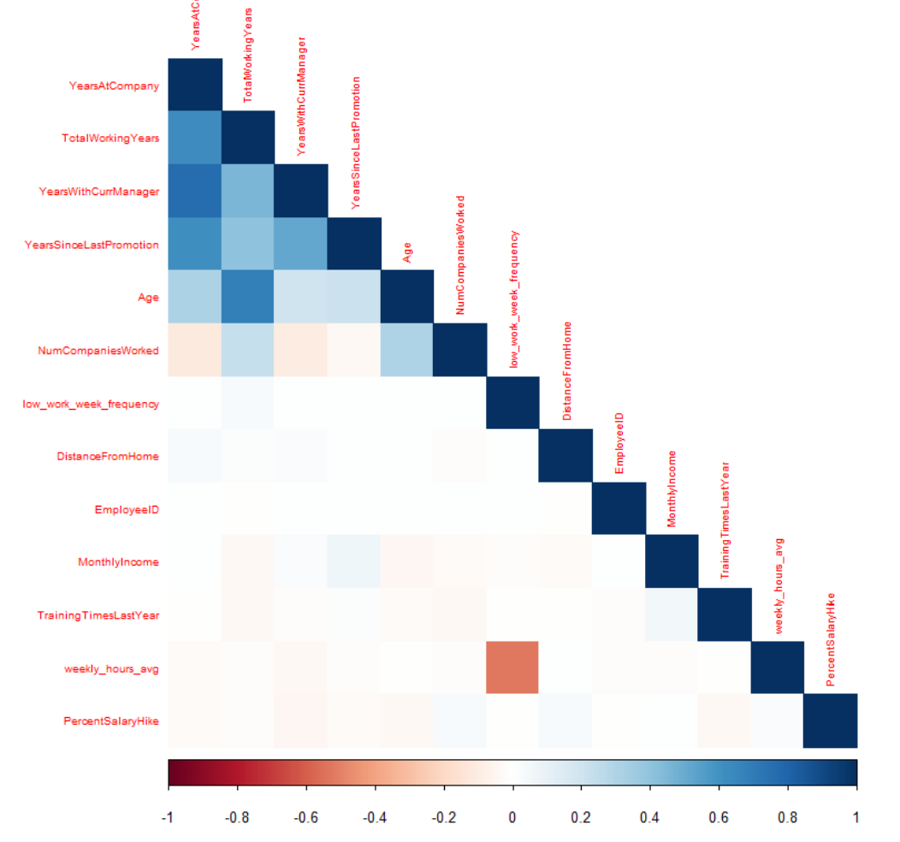
Data Correlation
Checks the correlation between each variable for further modeling

Slide 13
Steps for Model Creation (Logistics Regression)
Monthly Income Scaled
Data split by 70% for training and 30% for testing
Initial Model run with 65 Variables (AIC 2094, Null Deviance 2728 and Residual Div 1960)
Performs step wise model selection by StepAIC and reduced the variable length to 41
VIF comparison with variable significance
Conclude the final model
Model Evaluation

Slide 14
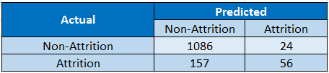

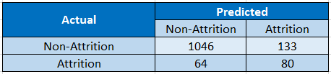

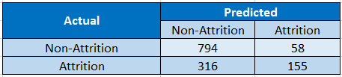

Model Evaluation
Probability Cut-off of 50%
Confusion Matrix and Statistics (40%)
Confusion Matrix and Statistics (20%)

Slide 15
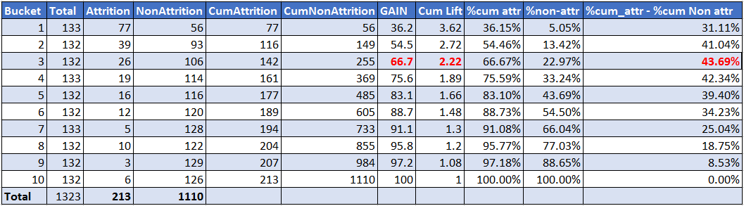
Calculation Gain, Lift and KS Statistics

Slide 16
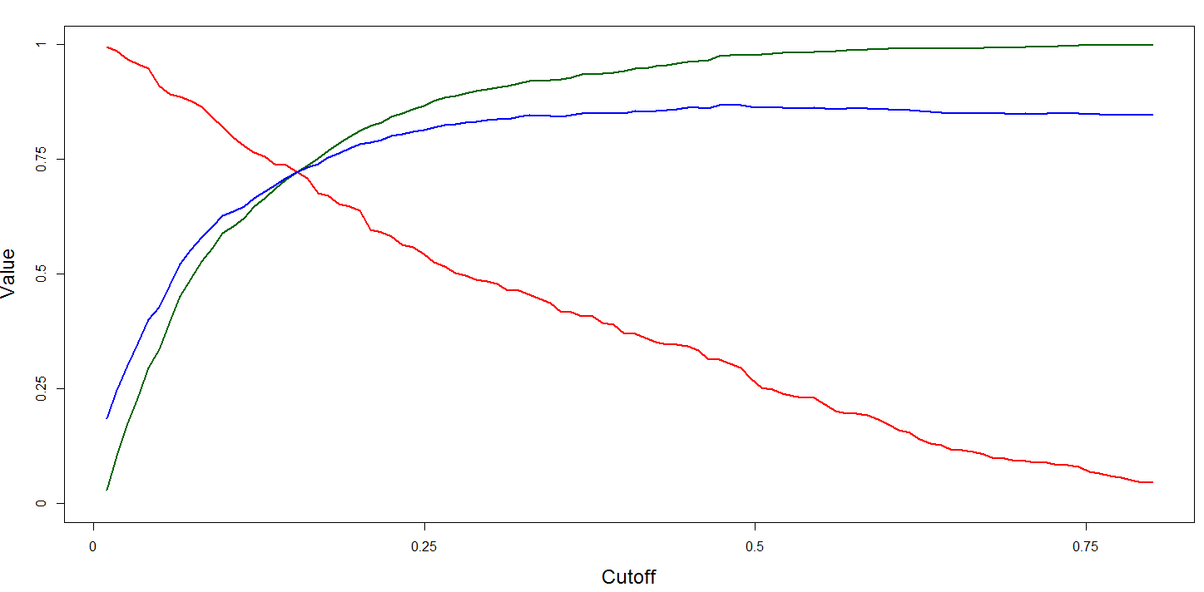

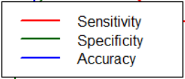
Model Evaluation Metrics
20% was finalized as the cut-off value due to acceptable sensitivity and maximum KS Statistics value

Slide 17
Problem Identified and Corresponding Resolution
Variables | Problems | Recommendations
Weekly Hours | Tends to be the most impacting factor on attrition. People who working more than 45 hours a week tends to be leaving the company | Ensure better work load distribution and better work life balance
Age Group 50+ & Age Group 36-50 | Young crowd, below 35 years tends to be leaving the company faster than the ones above 35 year of age | Recognize the young talents, understand their concerns, reward and promote them as deserved

Slide 18
Problem Identified and Corresponding Resolution
Variables | Problems | Recommendations
Business Travel Rarely & Business Travel Frequently | Employees who travel add to the attrition rate | Try to reduce travel frequency, try to give more opportunities for single people to travel than married ones as they may have family responsibilities, try to provide better or more disturbance allowance in case business travel is required. Try to hire onsite employees for the kind of role employees are travelling the most
Years With Curr Manager | It seems people who spend more time with same managers tend to stay | Try to get a 360 degree feedback on managers whose subordinates are leaving too fast and try to understand their concerns if any

Slide 19
Problem Identified and Corresponding Resolution
Variables | Problems | Recommendations
Years Since Last Promotion | It seems employees who have not been promoted for a while tend to leave | Have a certain promotion criteria which is measurable, Ensure that people are being promoted on fair grounds and when they well deserve it
Environment Satisfaction 2, Environment Satisfaction 3 & Environment Satisfaction 4 | While employees who rated 2 and above seems to stay, rating 1 tends to leave the company | look into detailed feedback from people who have rated 1 and take actions accordingly

Slide 20
Problem Identified and Corresponding Resolution
Variables | Problems | Recommendations
Department Research Development & Department Sales | Employees working in Development and Sales department tend to be staying a bit longer | Look into other departments concerns, understand from sales and development what is working in favor of them and apply the same to other departments
Job Satisfaction 4 | Rating below 4 tend to be addition on to attrition rate | Look into detailed feedback for below 4 rating and take actions accordingly

Slide 21
Problem Identified and Corresponding Resolution
Variables | Problems | Recommendations
Total Working Years Group 11-40, Total Working Years Group 3-5 & Total Working Years Group 6-10 | Employees with less than 3 years experience tend to be leaving faster | Once an employee completed 2.5 years, understand their concerns , their ambitions, career path they want to achieve, expose them to new opportunities, provide them with training, promote them if they are performing well and give a remarkable hire which is not less than 15%
Number of Companies Worked | Rating below 4 tend to be addition on to attrition rate | screen for candidates who have stayed with companies fro longer and not the ones who kept changing companies one after other

Slide 22
Problem Identified and Corresponding Resolution
Variables | Problems | Recommendations
Marital Status Single | Single Employees ted to have less liability and hence may think of changing jobs more frequently. | Like some companies have family days, Have a singles day as well for single employees to interact and know each other. Provide a Marriage bonus which could be one months salary and also a marriage leave of 5 days to appease the single employees to stay in the company until they get married.

